Slide 1
Quantization
Quantization Flow of
Convolution, Concatenate, Element-Wise Add
AIRD - George Tseng
2021/08/05

Slide 2
Agenda
Introduction
What’s Quantization?
Why’s Quantization?
How’s Quantization?
Example_1
Asymmetric V.S. Symmetric
Example_2
Quantization Convolution BatchNorm
Example_3
Quantization Flow
Example_4
Advanced
Per-channel Quantization
Quantization Aware Training

Slide 3
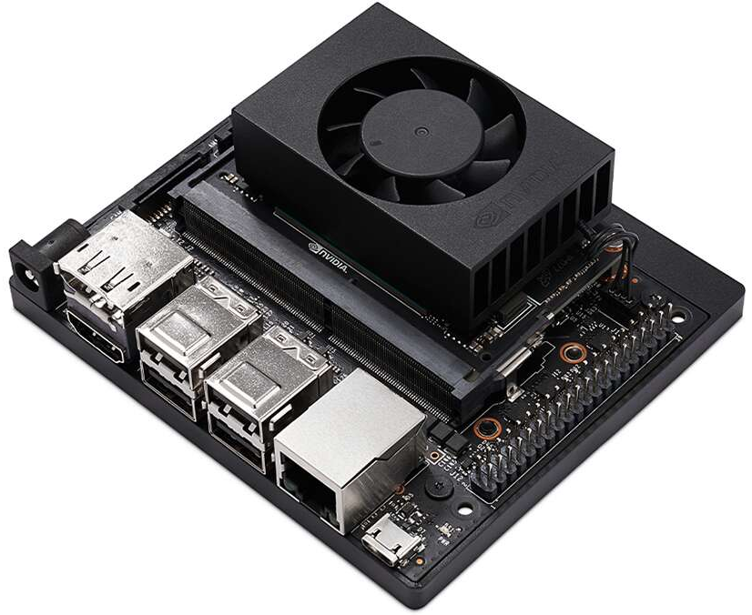
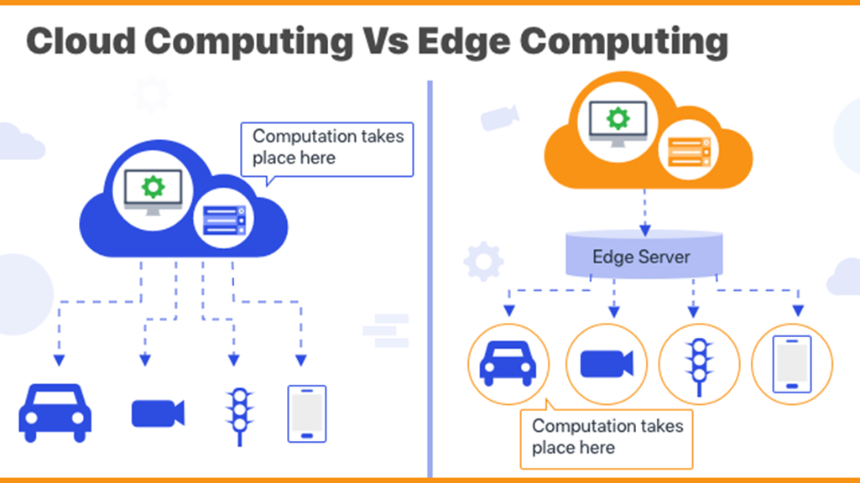
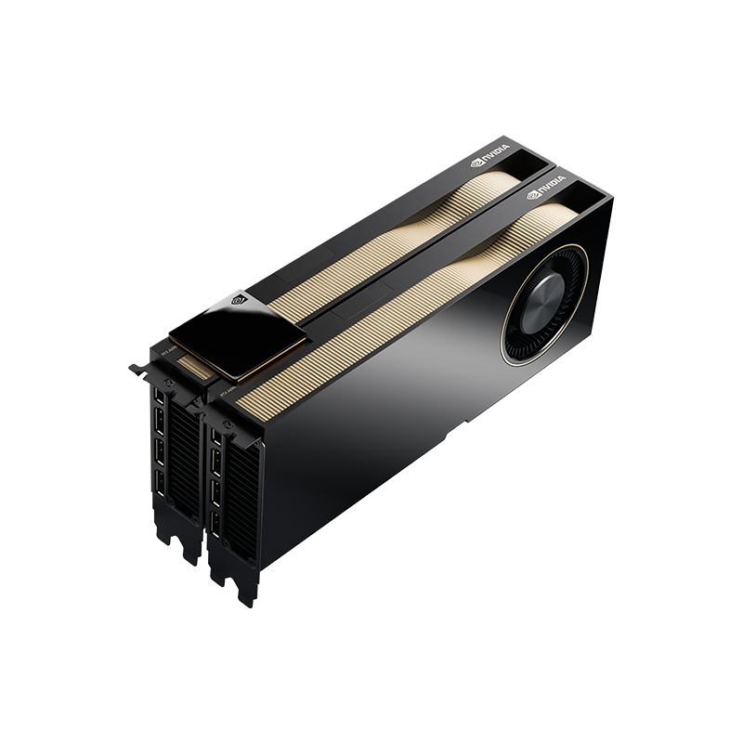
Why Quantize?
Edge Computing
問題: 體積小、低功耗、硬體資源有限
方法: 模型輕量化、模型加速
Xavier NX
GPU MEM 8GB
PW: 15W
RTX A6000
GPU MEM 48GB
PW: 300W

Slide 4
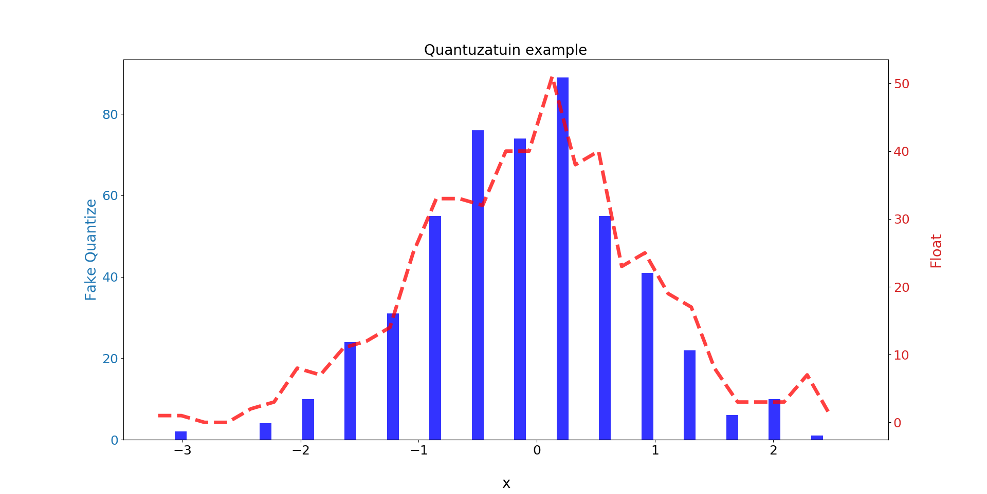
What Quantize?
將數據壓縮到較低精度的bit數(ex. FP32 to INT4)
yf = fp32(500), 500*32bit = 16000bit
yq = int4(500), 500*4bit = 2000bit
參數量差8倍

Slide 5
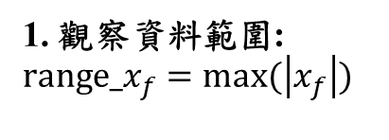
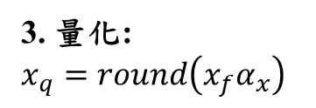
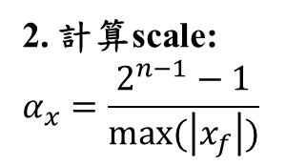
How Quantize?
1. 觀察資料範圍:
$$range_x_{f}=max⁡(\left|x_{f}\right|)$$
2. 計算scale:
$$α_{x}=\frac{2^{n−1}−1}{max⁡(\left|x_{f}\right|)}$$
3. 量化:
$$x_{q}=round\left(x_{f}α_{x}\right)$$
For Symmetric

Slide 6
Example Code example_1_sample_quantization.ipynb 10 minutes

Slide 7
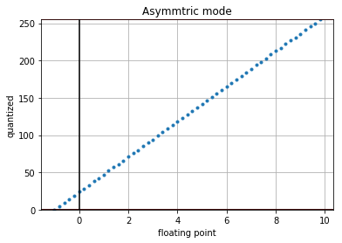
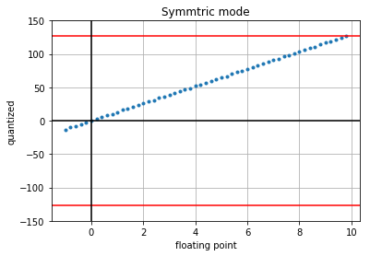
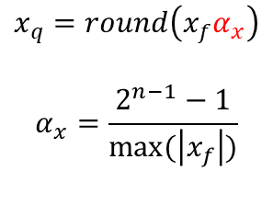
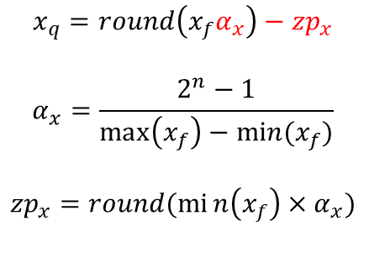
Quantization Method: Asymmetric V.S. Symmetric
127
No use
-128
$$x_{q}=round\left(x_{f}α_{x}\right)−{zp}_{x}$$
$$α_{x}=\frac{2^{n}−1}{\max\left(x_{f}\right)−min⁡(x_{f})}$$
$${zp}_{x}=round(min\left(x_{f}\right)×α_{x})$$
$$x_{q}=round\left(x_{f}α_{x}\right)$$
$$α_{x}=\frac{2^{n−1}−1}{max⁡(\left|x_{f}\right|)}$$
觀察資料範圍
The quantized range is fully utilized
The quantized range is not fully utilized
The zero points require additional logic in HW
The symmetric No zero points

Slide 8
Example Code example_2_symmtric_vs_asymmtric.ipynb 10 minutes

Slide 9
Quantization Style
Symmetric
Asymmetric
Per-layer
Per-channel
Post-Training Quantization
Quantization Aware Training

Slide 10
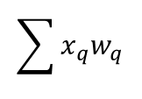
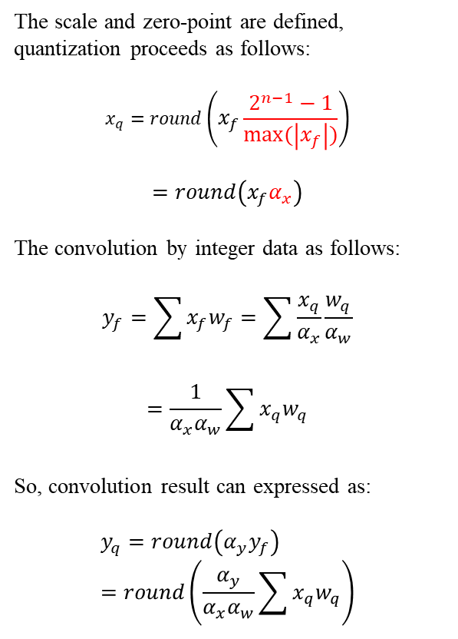




Quantization Convolution
The scale and zero-point are defined, quantization proceeds as follows:
$$x_{q}=round\left(x_{f}\frac{2^{n−1}−1}{max⁡(\left|x_{f}\right|)}\right)$$
$$=round\left(x_{f}α_{x}\right)$$
The convolution by integer data as follows:
$$y_{f}=\sum{x_{f}w_{f}}=\sum{\frac{x_{q}}{α_{x}}\frac{w_{q}}{α_{w}}}$$
$$=\frac{1}{α_{x}α_{w}}\sum{x_{q}w_{q}}$$
So, convolution result can expressed as:
$$y_{q}=round\left({α_{y}y}_{f}\right)=round\left(\frac{α_{y}}{α_{x}α_{w}}\sum{x_{q}w_{q}}\right)$$
$$\sum{x_{q}w_{q}}$$
$$x_{q}$$
UINT8
Accumulator
$$w_{q}$$
INT32
UINT8
$$y_{q}$$
UINT8
$$\frac{α_{y}}{α_{x}α_{w}}$$

Slide 11
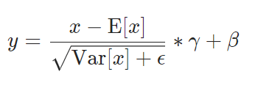
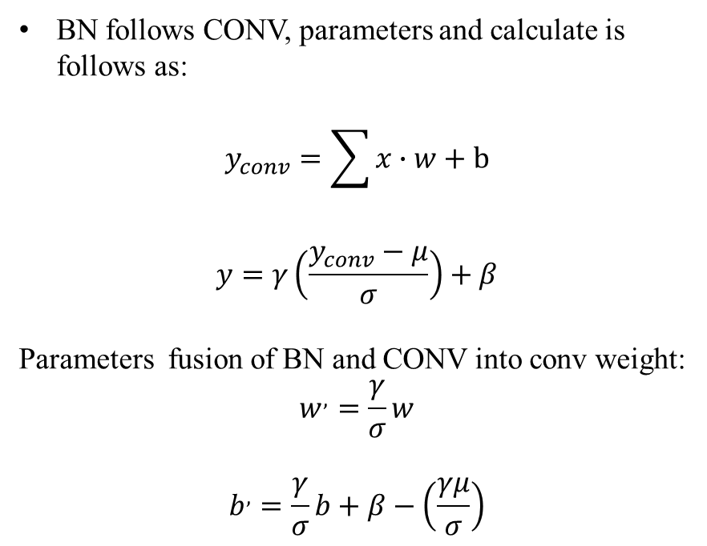


Quantization BatchNorm with Convolution
BN follows CONV, parameters and calculate is follows as:
$$y_{conv}=\sum{x∙w}+b$$
$$y=γ\left(\frac{y_{conv}−μ}{σ}\right)+β$$
Parameters fusion of BN and CONV into conv weight:
$$w^{,}=\frac{γ}{σ}w$$
$$b^{,}=\frac{γ}{σ}b+β−\left(\frac{γμ}{σ}\right)$$
$$μ$$
$$σ$$
CONV
CONV
BN
ReLU
ReLU

Slide 12
Example Code example_3_conv_bn_relu.ipynb 10 minutes

Slide 13

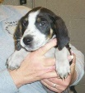
Quantization Flow
Model
CONV+BN
Calibration dataset
Observe the data distribution of the parameter layer
Calculate scale and quantize model
Inference quantization model
X
quant
X
CONV
X
CONV
ReLU
CONV
observer
Data range
scale
BN
quant
ReLU
ReLU
observer
Data range
scale
FC
FC
quant
FC
Y
observer
Data range
scale
Y
Y

Slide 14
Example Code example_4_quantize_model_calssifier_cat_dog.ipynb 10 minutes

Slide 15
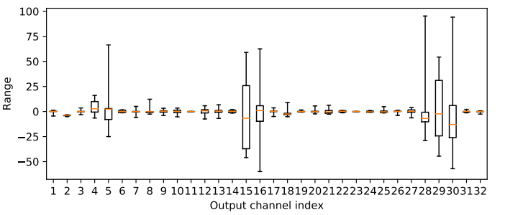
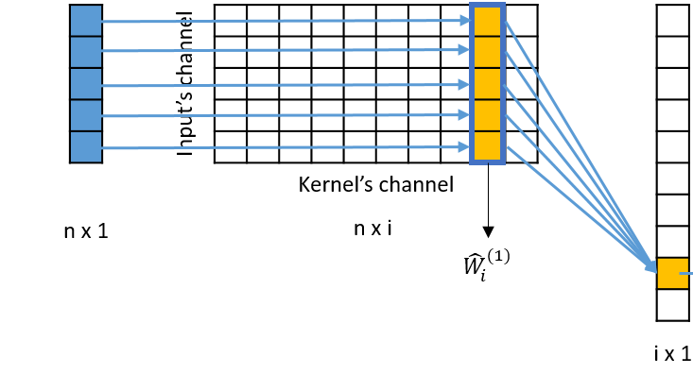
Per-channel v.s. Per-layer Quantization
Data: -25.0~75.0
bin: 0.59
α_{all}
α₅
Per-layer
α₁
α₃
α₄
α₇
α₈
α₉
α₁₀
α₂
α₆
Per-channel
Data: -1.0~1.0
bin: 0.0078

Slide 16
Quantization Aware Training
Inference
Training
X
X
CONV
observer
Data range
scale
Fake
quant
ReLU
CONV
observer
Data range
scale
ReLU
FC
Y
observer
Data range
scale
Fake
quant
FC
Fake
quant
Y

Slide 17
Thank you

